Slide 1
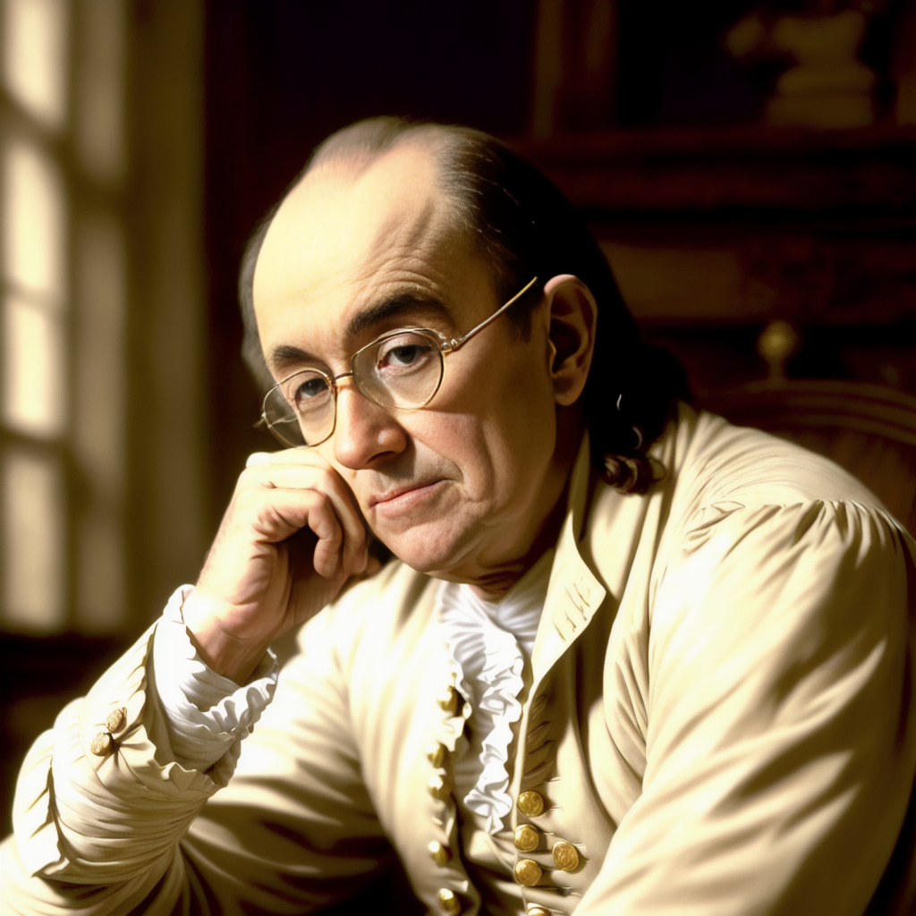
Make
Great Decisions
using Ben Franklin’s
Decision Making Method

